Slide 1
Face Recognition Model
Submitted by:
Mr Ajith P. Kumar
Submitted to:
Mr S. Ranjan

Slide 2
About
A face recognition model is a type of machine learning model designed to identify or verify individual faces in images or videos

Slide 3
Key Factors
Detecting the face in an image and cropping it to focus on facial features.
Encoding the face into a unique numerical representation (embedding) that captures the essential features of the face.
Comparing the encoding with known face encodings to determine if there's a match or to identify the person.

Slide 4
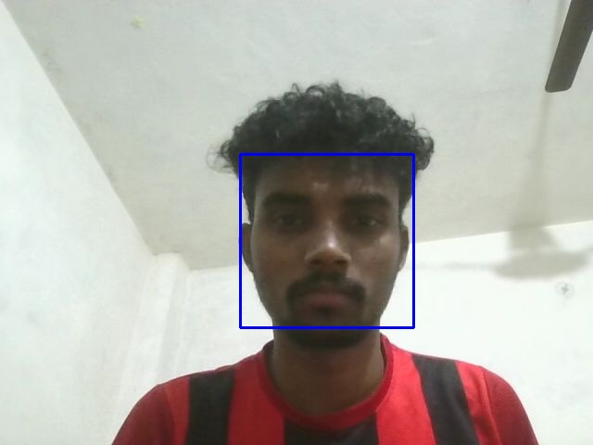
Face detection
Utilized the OpenCV library and Haarcascade classifier to detect face in a photo.
The Ipython library provided different methods to access and display the images in Google colab.

Slide 5
My Model
In my model I’ve extended the face recognition library.
It utilises the HOG(Histogram of oriented gradients) model for face detection.
Implements face distance comparison for best match.
Draws bounding boxes and labels in real-time.

Slide 6
libraries
IPython.display: For displaying content in Jupyter/ Colab notebooks
PIL: For editing, creating and saving images
face_recognition: Main library for face detection and recognition
OpenCV: For image processing and drawing
numpy: For numerical operations
base64: For encoding/decoding image data
ipywidgets: For interactive widgets in notebooks

Slide 7
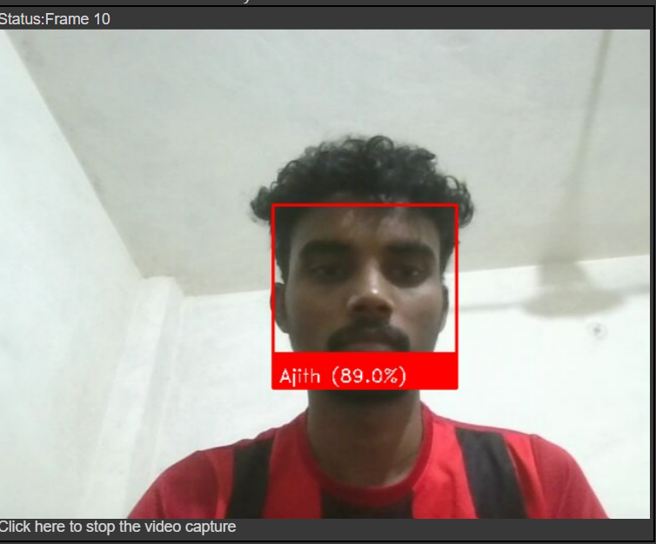
result

Slide 8
Thank You

